Slide 1

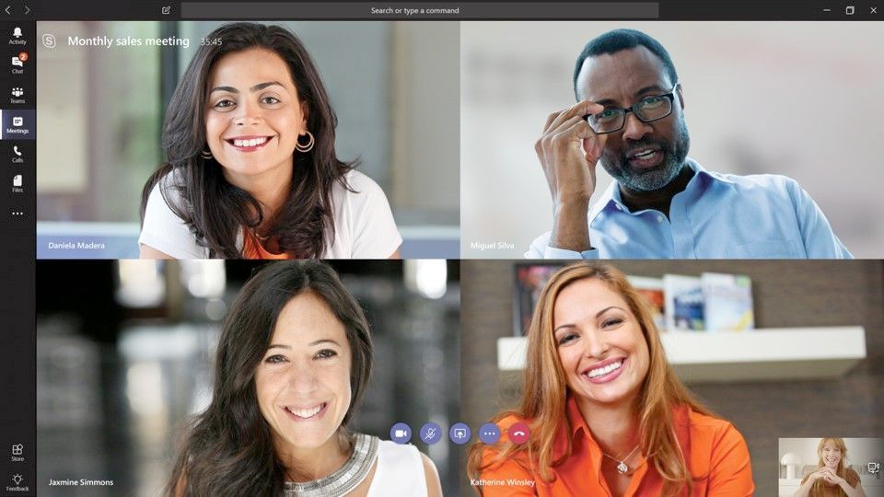

Now is the time for
Microsoft Teams
83% say
“Teams has helped my organisation improve customer experiences.”
Stay in touch with the hub for teamwork in Office 365
Connect, collaborate and come together by meeting with your peers and getting work done anywhere – even remotely.
Communicate more effectively
Work better together
Get your team on the same page with group chat, online meetings, calling and web conferencing
Collaborate on
files with built-in Office 365 apps like Word, Excel, PowerPoint, and SharePoint
Add in your favourite Microsoft apps and third-party services to keep the business moving forward
Get end-to-end security, admin control and compliance – all powered by
Office 365
Customise your workspace
Keep your team secure
“Our previous, on-premises Microsoft solutions were end of life.
We moved to Teams in the cloud to save money and
create more flexible working.”
GM, Telecoms industry
¹The Total Economic Impact™ Of Microsoft Teams: A Forrester Total Economic Impact™ Study Commissioned By Microsoft, April 2019

